Slide 1
SIMPLE GUI CALCULATOR
Calculator using Tkinter python

Slide 2
INTRODUCTION
The calculator is a basic utility to add, subtract,multiply, divide, and do other basic mathematical operations easily.
It is simpy a simple mathematical operator , one can say.
Acalculator is a machine which allow people to do math operation more easily.
For eg. Most calculator will add,subtract,multiply,and divide.

Slide 3
USING TKINTER PYTHON
Tkinter is an open source,portable graphical user interfeace (GUI) library designed for use in python scripts.
Create GUI calculator is only a calculator but one can use it by clicking buttons, not by typing something like in python print (2+2), and then will gel the result as 4 in the back and white environment.In the GUI calculator,all its operators and numbers are respesented graphically and one can click it and use it.

Slide 4
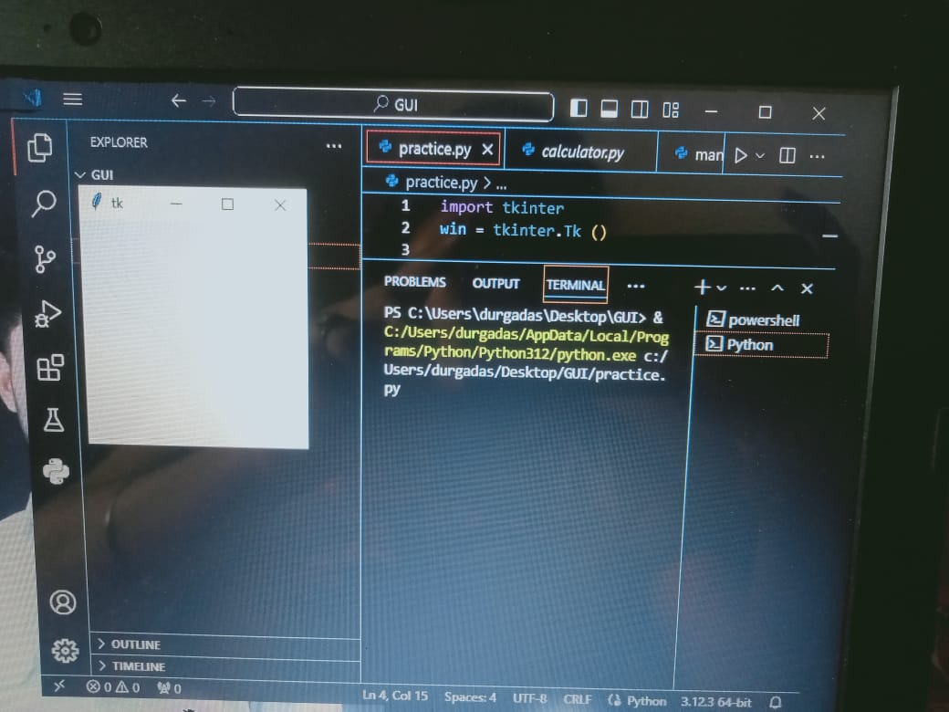
HOW TO WORK TK ?
* In order to create the calculator first,we have to install a GUI library on our system.
from tkinter import *
*Create variable ‘win’ to to stone TK library
With below create a window for calculator
win =TK()
win.mainloop()

Slide 5
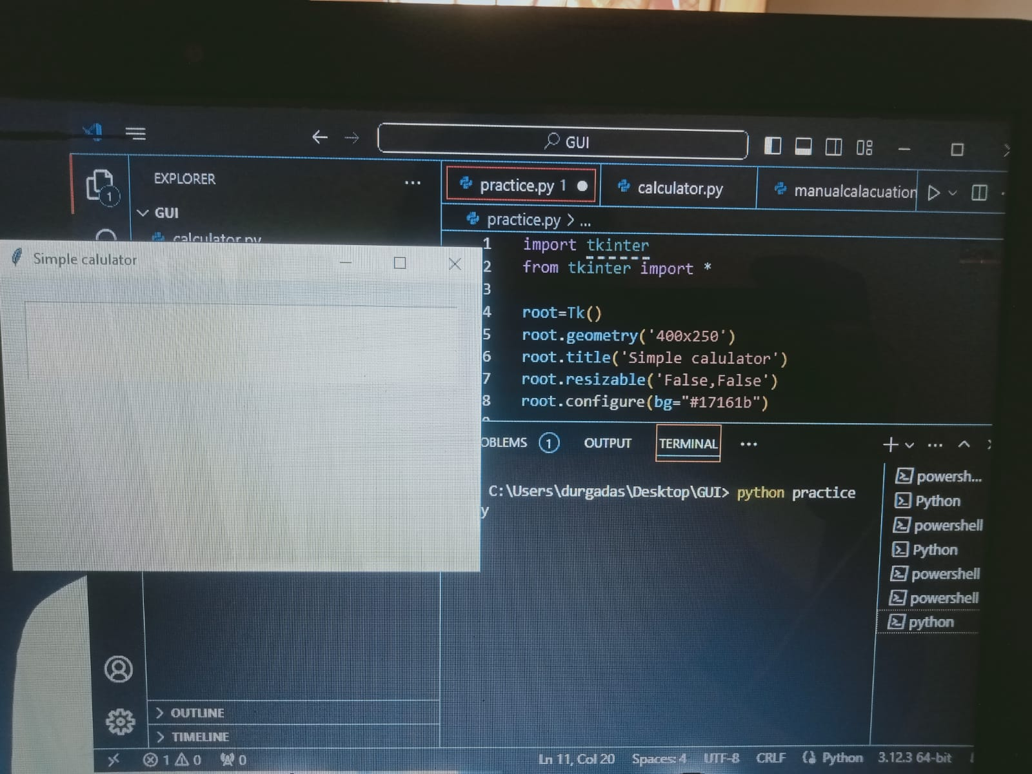
STEP I
Input_text =_StringVar()
A variable defined using StringVar() holds a string data where we can set text value and can retrieve it.Also,we can pass this variable to a text variable parameter for a widget like Entry.The widget will automatically get updated with the new values whenever the value of StringVar () variable changes.
Create a Frame for input field and inside we create input field to show experession
Input _ frame =_Frame()
Input _ frame. pack()
input _ field_Entry()
input _ field.grid()
input _ field.pack()

Slide 6
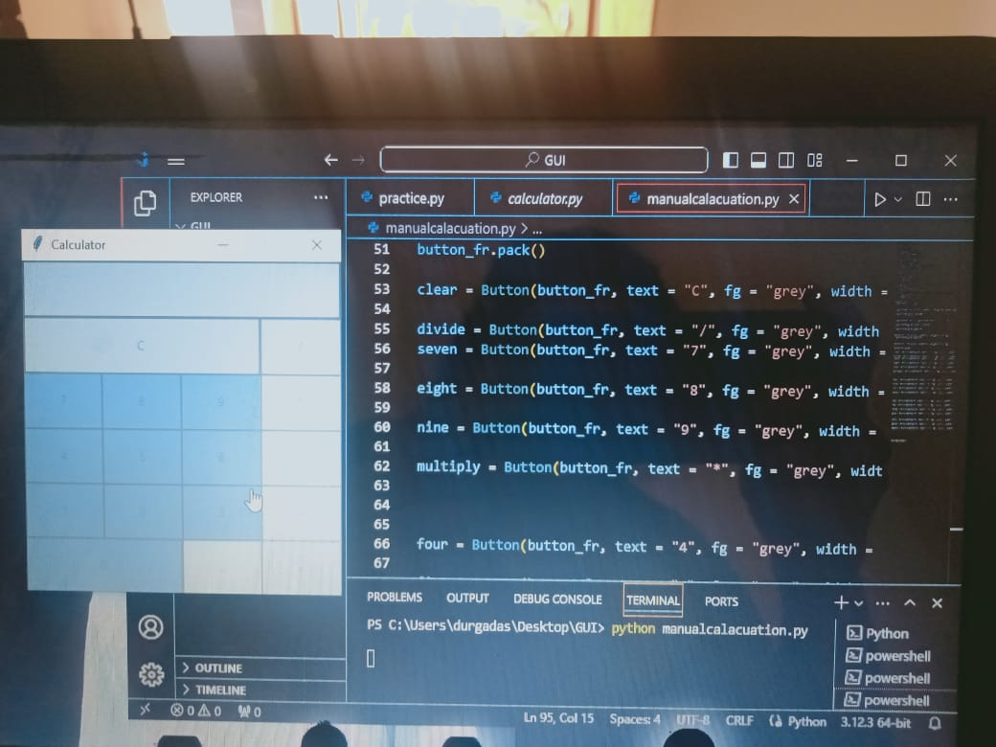
STEP II
* We create the button like digit 1,2,3....,add del,division and all.We use the below code.
Btns _ frame = Frame()
Btns _ frame.pack()
* In the first row we create clear and division.
clear = Button()
divide = Button()
* Here we are the command bu on button click.
command_ lambda.bt_clear()

Slide 7
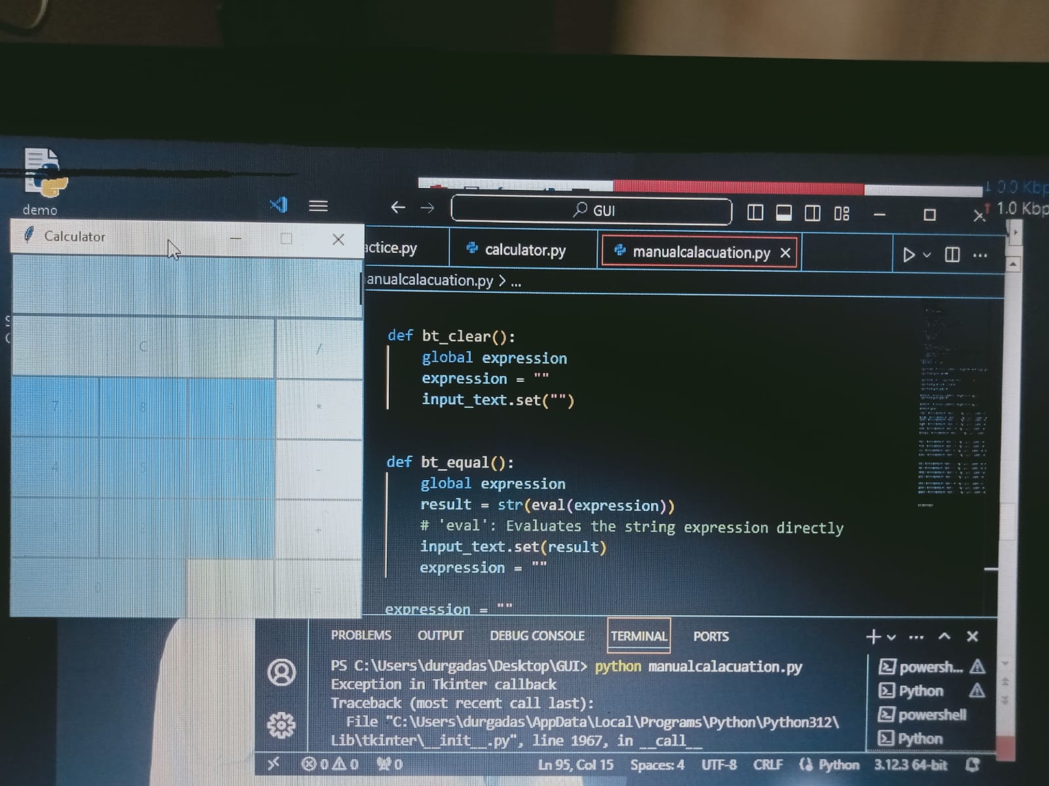
STEP III
* Our calculator GUI is read but not funactionally working for this we create clear,click and expel to function.
def bt _clear():
* This function is used to handle the clear operation to clean the previous input in the Calculator.
def btn _ click(item):
* This function handle the button click on various numeric button to add them to the operation.
def bt _equal():
* This function is used to handle the equal button to execuie the operation and show the result.

Slide 8
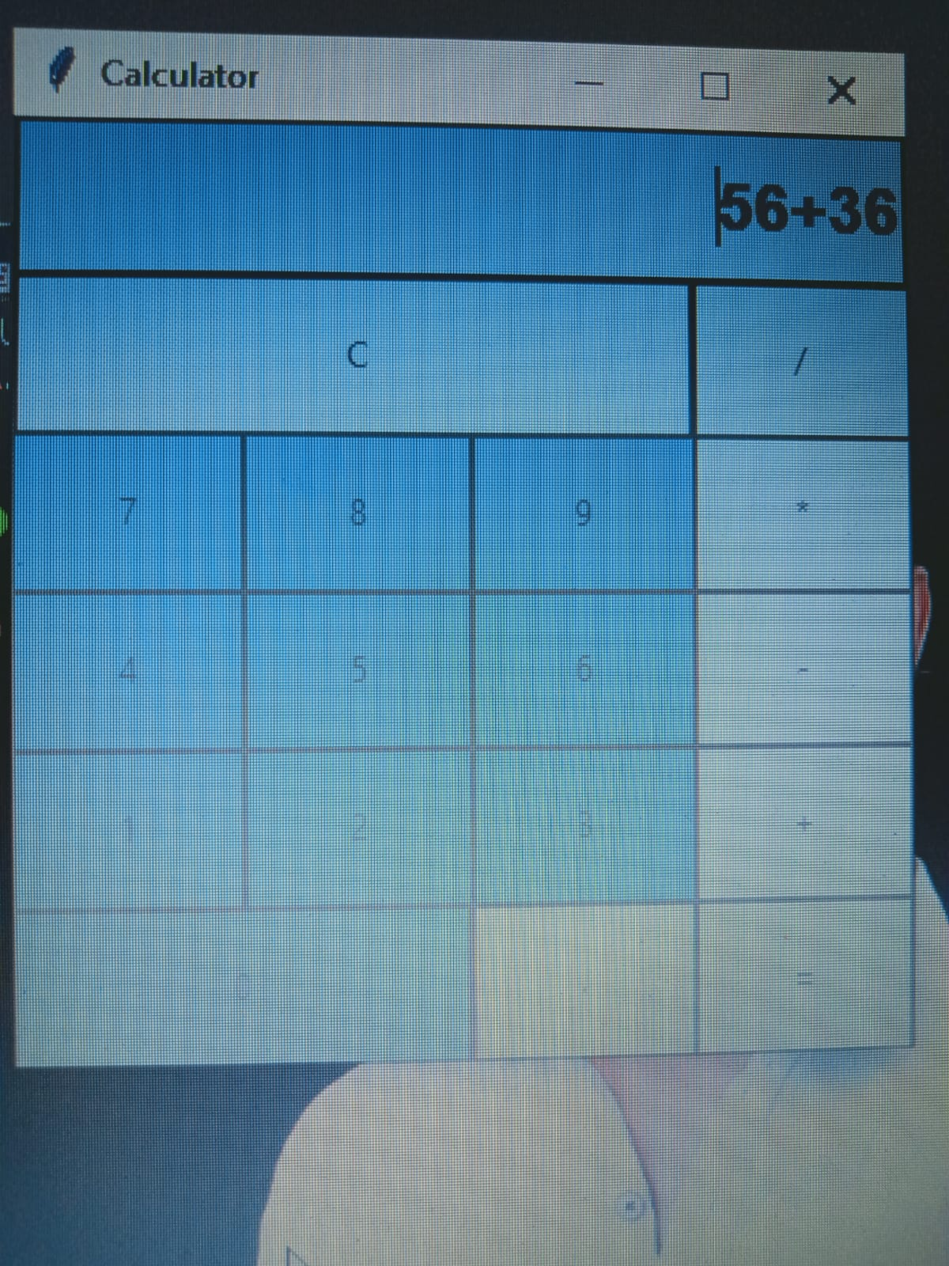
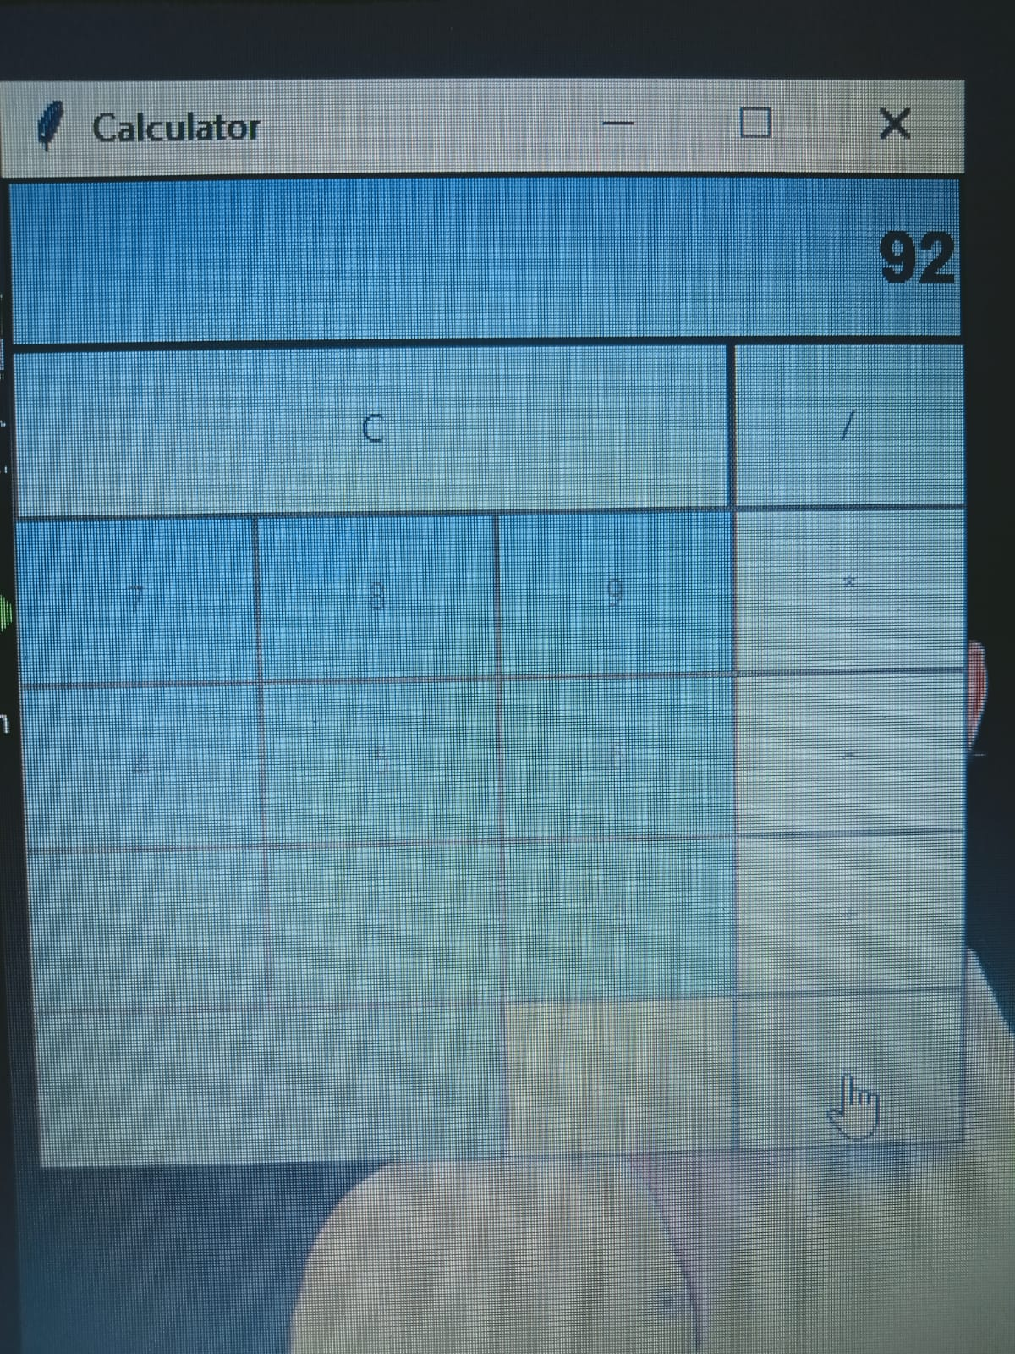
CALCULATOR IS READY

Slide 9
CONCLUSION
* Therev are a variety of function in Tkinter with the help of them it becomes easy and convenint to make a simple calculator. And in the GUI calculator, all its operators and numbers are represented graphically and one click it and use it.

Slide 10
THANK YOU

